Slide 1

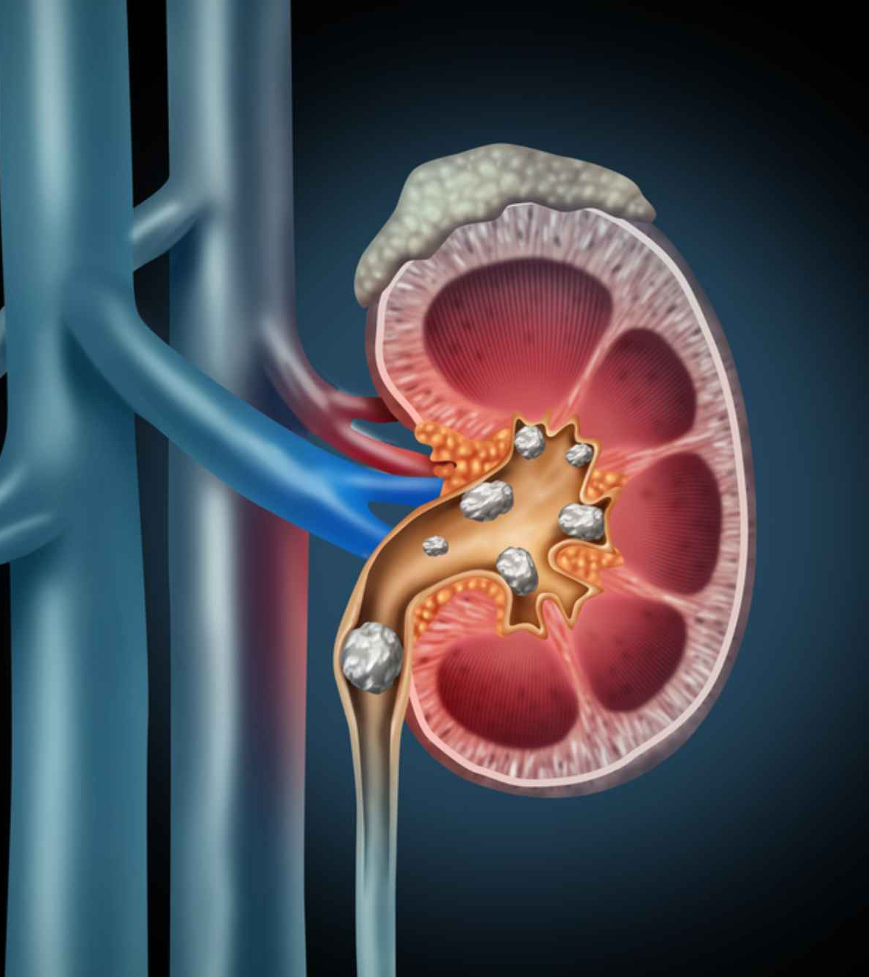




Chronic Kidney Disease
MIS637 – B Data Analysis and Machine Learning
Submitted By:
Rutvi Sutariya
Guided by: Prof. Mahmoud Daneshmand

Slide 2
Agenda
Introduction
PROBLEM DESCRIPTION
CRISP-DM
BUSINESS UNDERSTANDING
DATA UNDERSTADING
DATA PREPARATION
MODELING
EVALUTION
DEPLOYMENT
CONCLUTION

Slide 3
INTRODUCTION
What is CKD?
CKD is a progressive condition where the kidneys gradually lose function over time.
Impact on People:
Asymptomatic: Often shows no symptoms in early stages, leading to late diagnosis.
Organ Impact: Affects kidneys' ability to filter waste, leading to cardiovascular issues, bone weakness, anemia, and decreased quality of life.
Financial Burden: CKD management can be costly due to treatments like dialysis and transplantation.

Slide 4
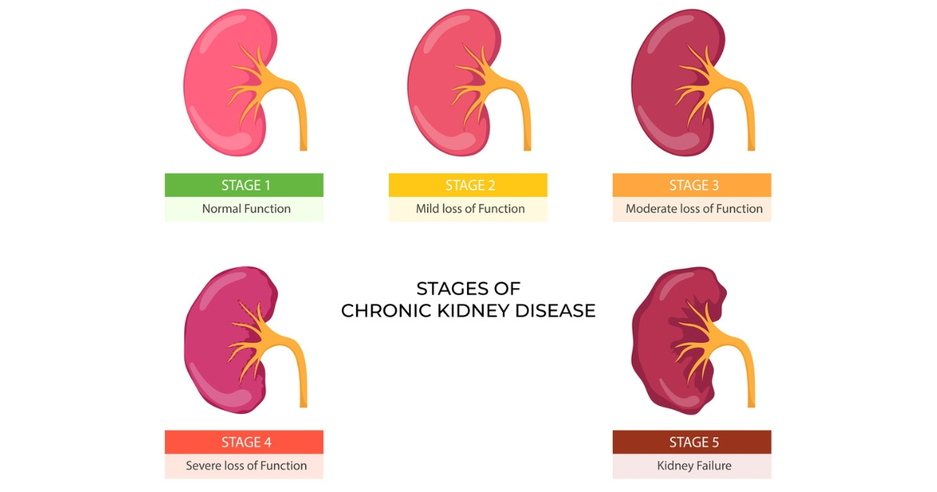
Problem Description
CKD dataset, a problem description usually aims to identify the significant predictors of kidney disease and to construct a predictive model that can accurately determine whether a patient has CKD based on various diagnostic measurements. The goal is often to assist healthcare providers in early diagnosis and intervention, improving patient outcomes.

Slide 5
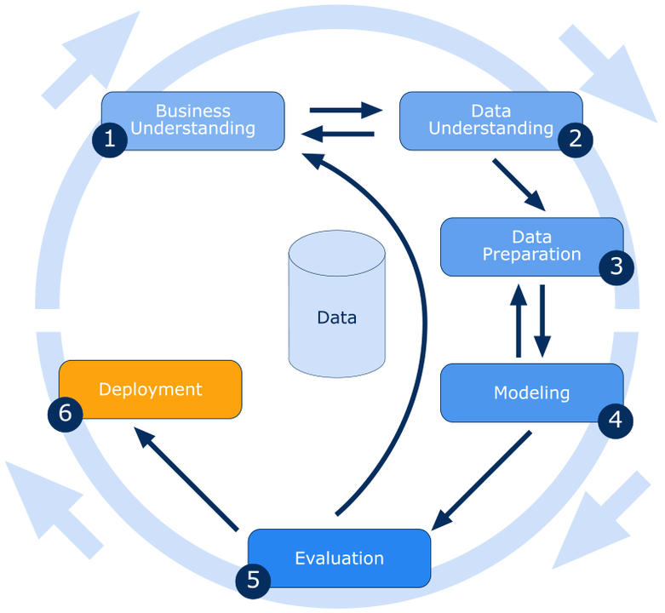
CRISP-DM
Business Understanding:
Define objectives for predicting CKD and understand business requirements.
Data Understanding:
Collect and explore relevant data sources: medical records, lab results, demographics.
Data Preparation:
Cleanse, preprocess, and transform data for modeling.
Modeling:
Choose ML algorithms (e.g., logistic regression, Random forest classifier, KNN) and train models.
Evaluation:
Assess model performance using accuracy, sensitivity, specificity, and ROC curves.
Deployment:
Integrate the model into clinical workflows for real-time CKD risk assessment.

Slide 6
Business Understanding
Objective: Predict CKD early for improved patient outcomes and reduced healthcare costs.
Challenges:
- Asymptomatic nature of early-stage CKD.
- High costs and complications associated with late-stage diagnosis.
Stakeholders: Healthcare providers, Patients, Insurance companies
Key Questions:
- What are CKD risk factors?
- How can early detection benefit patients and healthcare systems?
- What are the financial implications of late CKD diagnosis?
Goals:
- Early CKD detection to reduce complications.
- Improve patient quality of life.
- Optimize healthcare resource allocation.
Outcomes:
- Lower healthcare costs.
- Better patient outcomes.
- Enhanced healthcare efficiency.

Slide 7

DATA UNDERSTANDING
The dataset used for analysis contains medical records for 400 patients.
There are 26 features, including both numerical and categorical data.
Numerical features include age, blood pressure (bp), and various lab test results such as blood glucose random (bgr), blood urea nitrogen (bu), serum creatinine (sc), sodium (sod), and potassium (pot).
Categorical features include red blood cell count (rbc), pus cell (pc), anemia (ane), and others, which indicate specific conditions or observations.
The primary variable of interest, 'classification', denotes whether a patient has CKD (marked as 'ckd', 'ckd\t') or not (marked as 'notckd').
With 248 cases of CKD and 150 non-CKD cases, this dataset is somewhat imbalanced towards CKD cases, indicating a higher prevalence of disease within the dataset.
The dataset can facilitate various analyses, such as understanding the critical factors influencing CKD, building models to predict the onset of CKD, and comparing the significance of different health indicators in disease prediction.

Slide 8
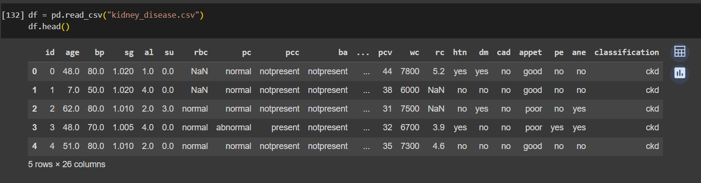
Chronic Kidney Disease dataset
https://www.kaggle.com/datasets/mansoordaku/ckdisease

Slide 9
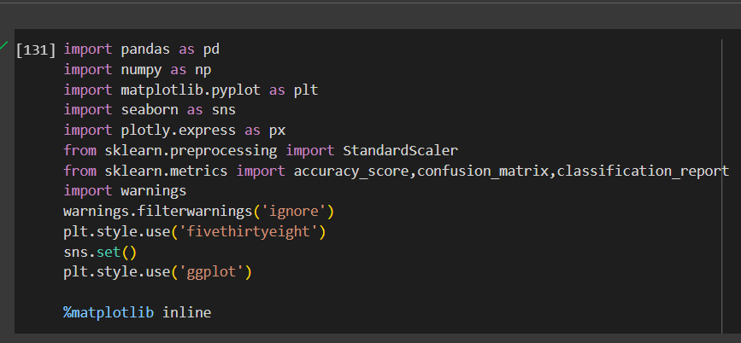
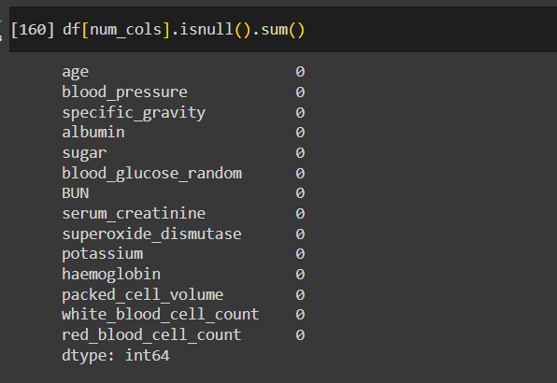
Data Pre-processing
Libraries for Data Handling and Visualization:
Imported essential libraries: Pandas for data manipulation, NumPy for numerical computations, Matplotlib and Seaborn for data visualization, and Plotly for interactive plots.
Handling Missing Data:
Executed an initial check to quantify missing values across the dataset to assess data integrity and identify potential gaps that require imputation or exclusion.

Slide 10
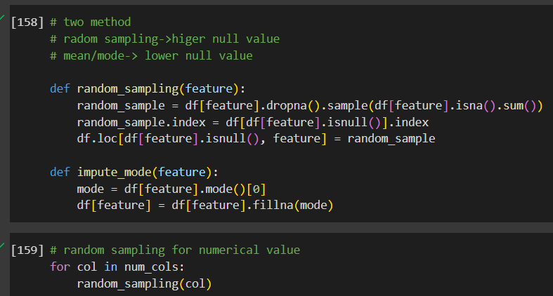
Data Pre-processing
handle missing data, which is a common problem in real-world datasets.
The random_sampling function could be particularly useful when the column has a significant amount of missing data. Using random sampling to impute values can preserve the original distribution of the data.
The impute_mode function is straightforward and often used when the number of missing values is relatively low and when it's safe to assume that the most frequent value is representative of the missing values.
Both methods are alternative to dropping rows with missing values or filling them with a central tendency measure (mean, median, or mode) and can help to retain valuable data that would otherwise be lost.

Slide 11
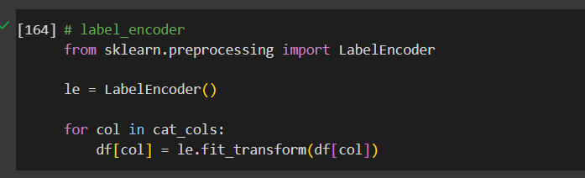
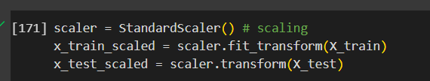
Data Pre-processing
Encoding Categorical Variables:
Utilized LabelEncoder to transform non-numeric categories into a numerical format that can be understood by machine learning algorithms, which is necessary for model training.
Feature Scaling:
Applied StandardScaler for normalizing numerical features to ensure that variables with larger scales do not dominate the model's feature importance, allowing for a balanced contribution across all features.

Slide 12
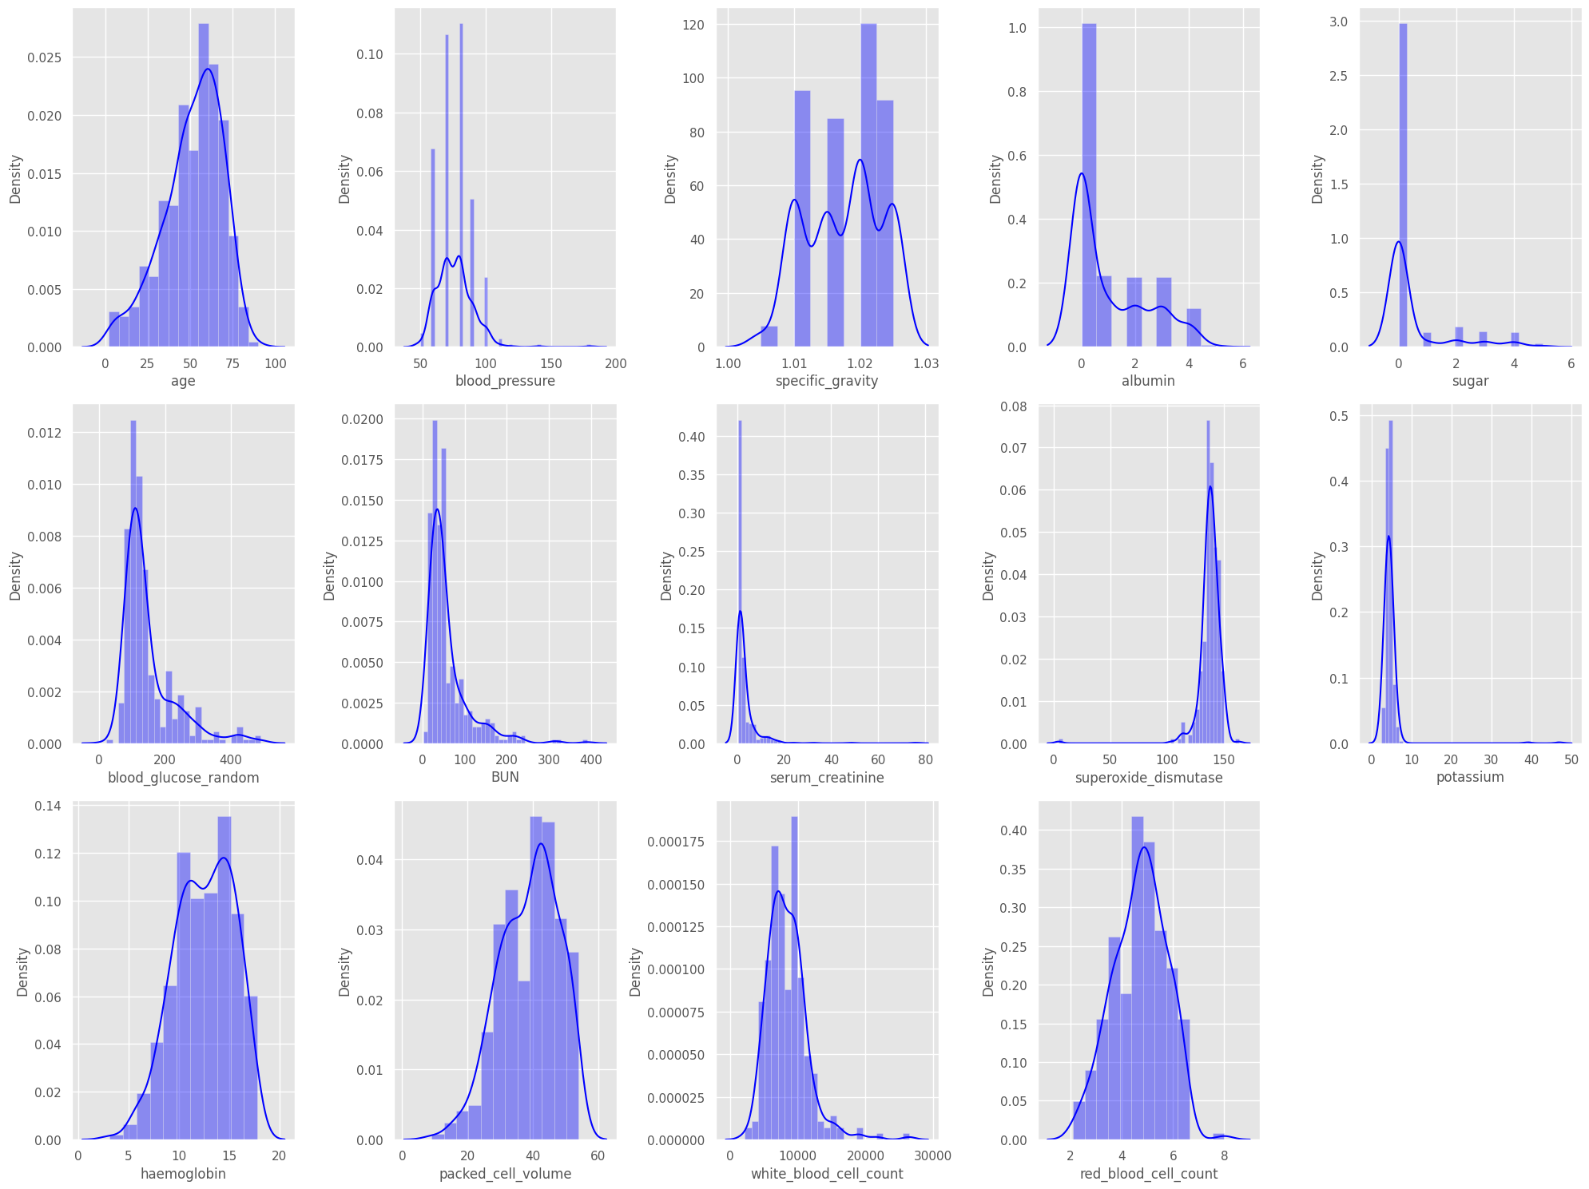
Data Pre-processing
We separated all the numerical features and created histograms of all those features.
Showing density plots for various numerical features such as age, blood pressure, and others. These density plots help in understanding the distribution of each numerical feature in the dataset.

Slide 13
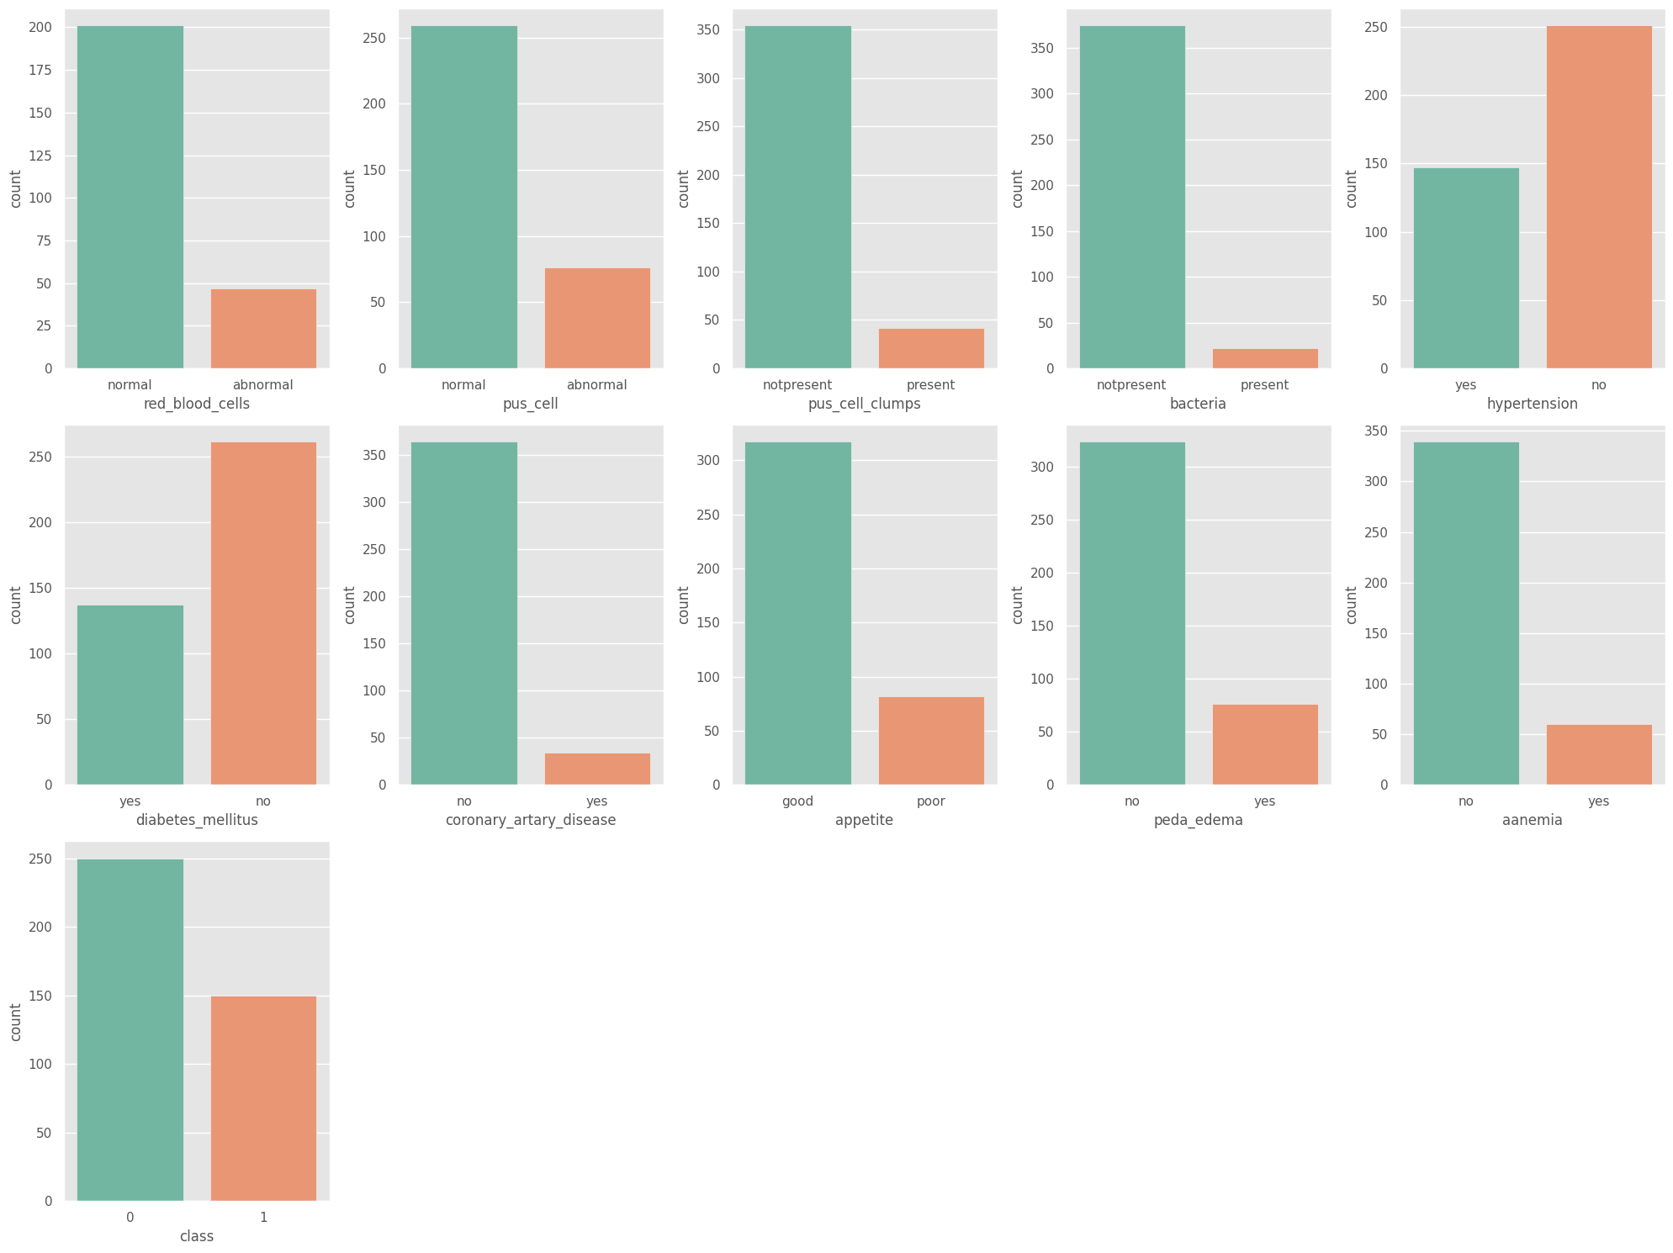
Bar plots for categorical columns
Each bar represents a category, and its height corresponds to the count of records within that category.
These plots are particularly useful for understanding the balance or imbalance of categorical features, which can have implications for model training and evaluation.

Slide 14
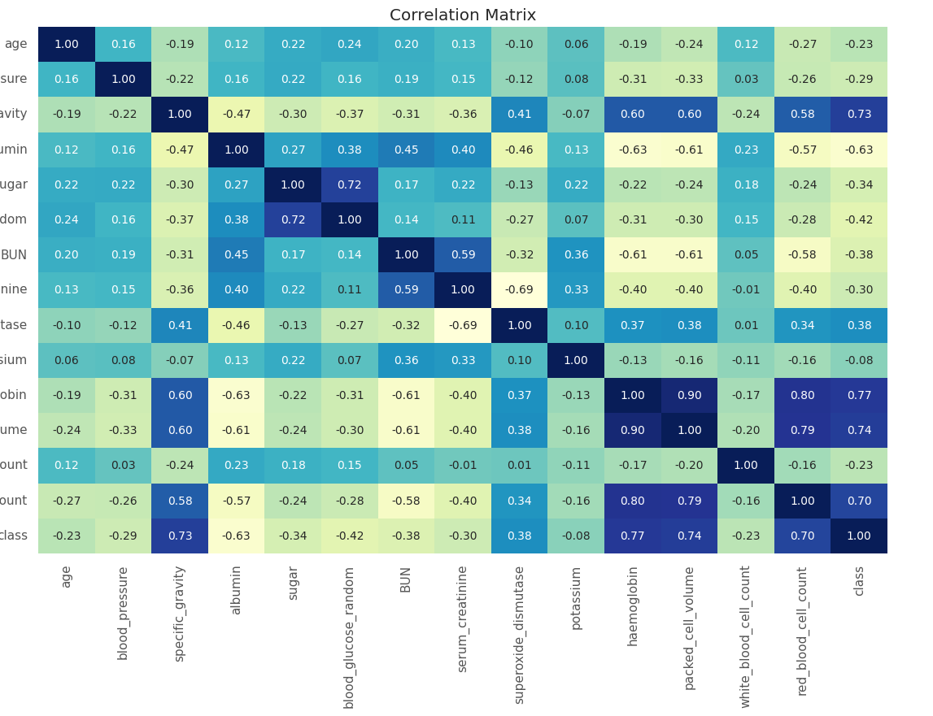
Numerical Features Correlation Matrix
We generated a correlation heatmap to identify relationships between numerical features, where the color intensity represents the strength of the correlation. Additionally, we visualized the distribution and outliers among the numerical data using box and density plots.
For categorical data, histograms displayed the frequency of categories, and cross-tab heatmaps illustrated the interactions between different categorical variables.
These steps are crucial for informed feature selection and model building in predictive analysis.

Slide 15
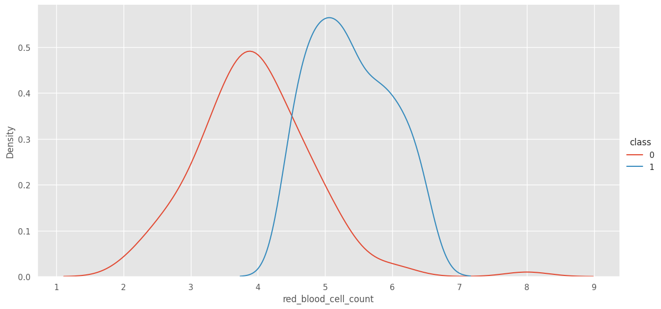
Data Visualization Kernel Density Estimate (KDE) Plot
The specific KDE plot shown indicates the differing distributions of red blood cell counts between the two classes, which could provide insights into how this metric correlates with the presence or absence of kidney disease.

Slide 16

MODELING
K-nearest neighbor with Cross Validation
Naïve-Bay’s
Logistic Regression with Cross Validation
Random Forest with Cross Validation

Slide 17
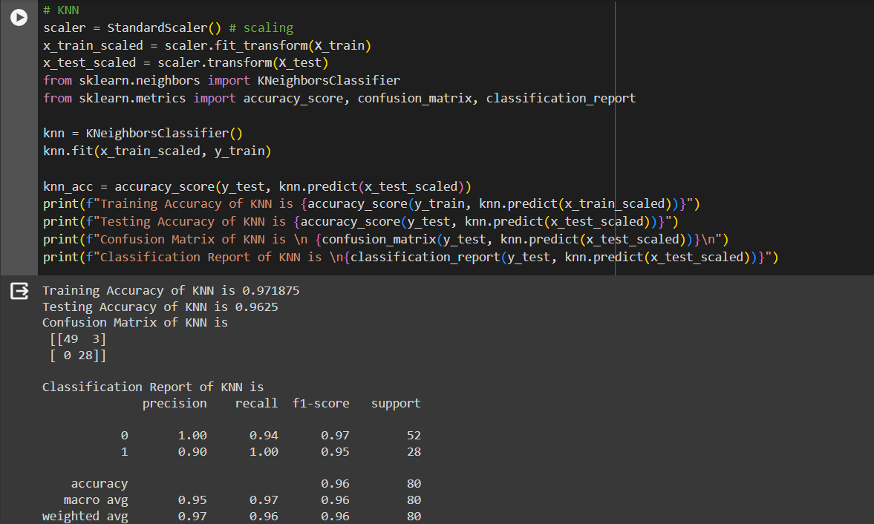
KNN – Cross validation
In this code, the K-Nearest Neighbors (KNN) algorithm is used for instance-based classification, making predictions by voting based on the k most similar instances and evaluating its effectiveness through accuracy and other performance metrics.
The Accuracy that we gained from this model is :-
Train.csv : 97.18%
Test.csv : 96.25 %

Slide 18
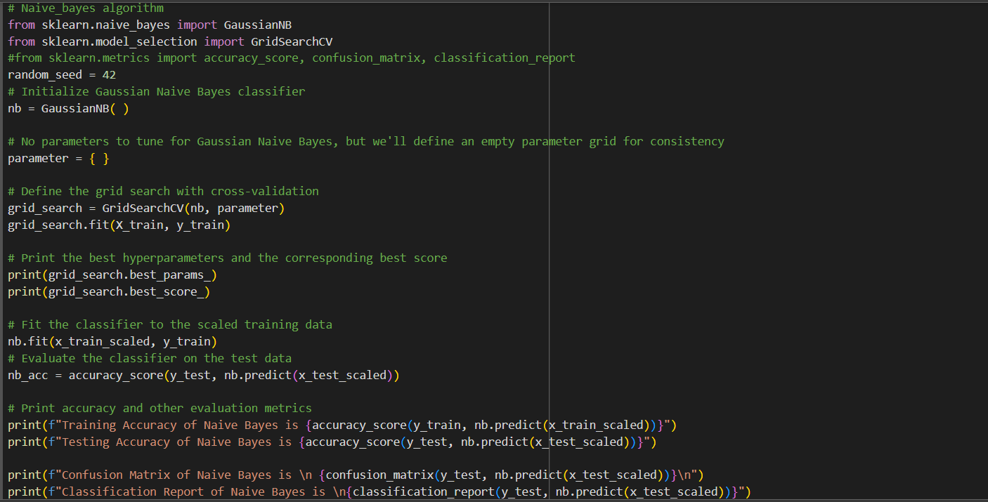
Naïve Bay’s Algorithm
In this code, the Gaussian Naive Bayes algorithm is employed as a probabilistic classifier to predict outcomes based on Bayes' theorem, with an evaluation of its accuracy and other performance metrics.
The Accuracy that we gained from this model is :-
Train.csv : 96.56%
Test.csv : 96.25%

Slide 19
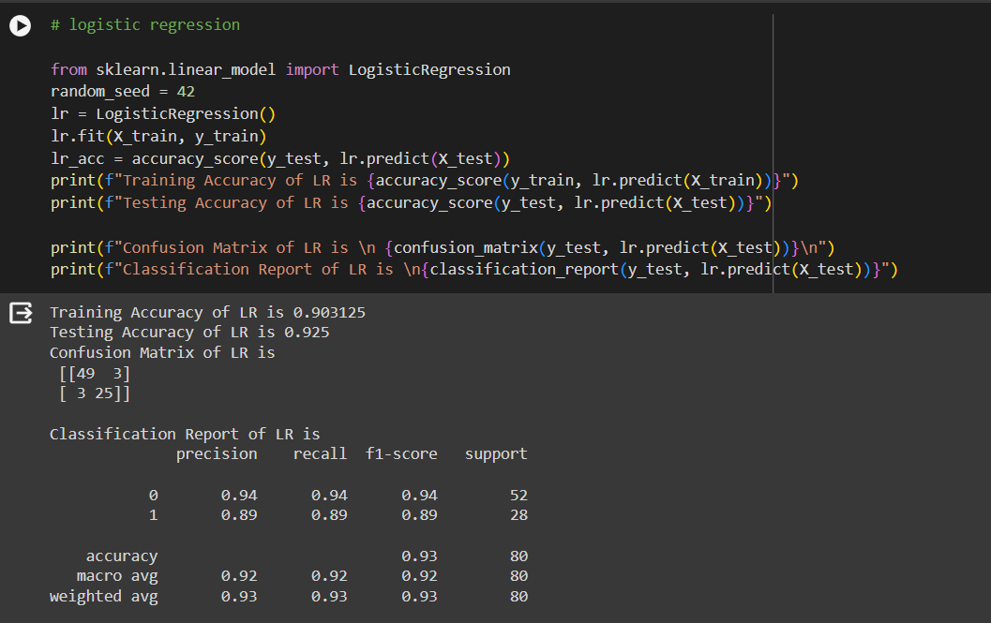
Logistic Regression
The Logistic Regression algorithm in this code is used for binary classification to predict categorical outcomes and assess the model's accuracy, precision, recall, and F1-score.
The Accuracy that we gained from this model is :-
Train.csv : 90.31%
Test.csv : 92.50%

Slide 20
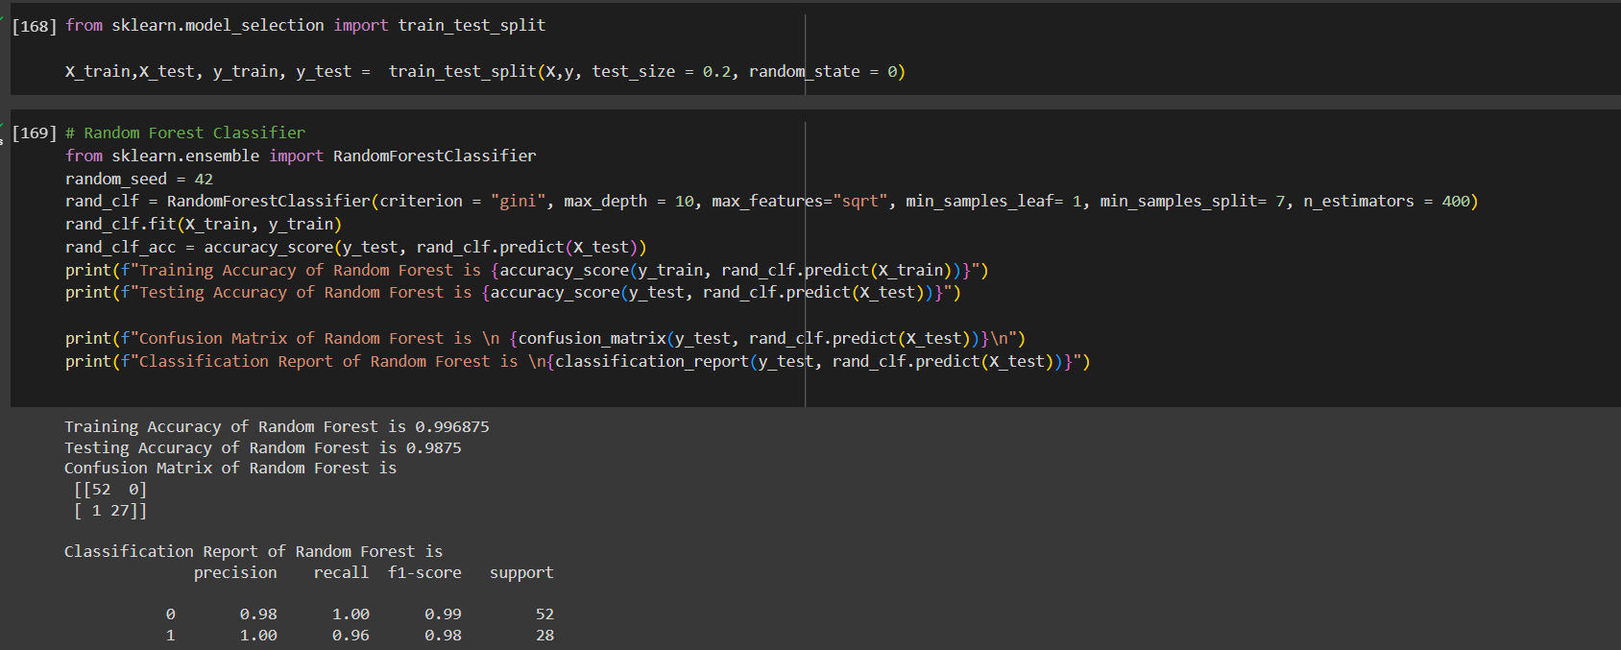
Random Forest Classifier
The Random Forest algorithm in this code is used to build a robust classification model that predicts outcomes based on an ensemble of decision trees, evaluated by its accuracy, confusion matrix, and classification report.
The Accuracy that we gained from this model is
Train.csv : 99.68%
Test.csv : 98.75%

Slide 21
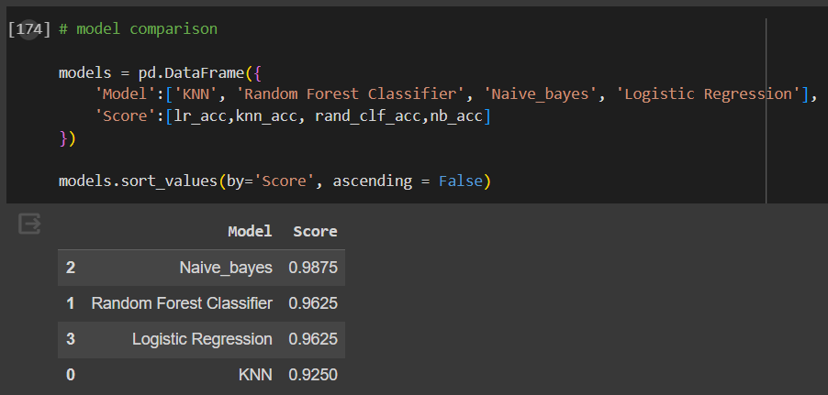
Accuracy Comparison
Random Forest Classification has predicted the highest accuracy compared to other models.

Slide 22
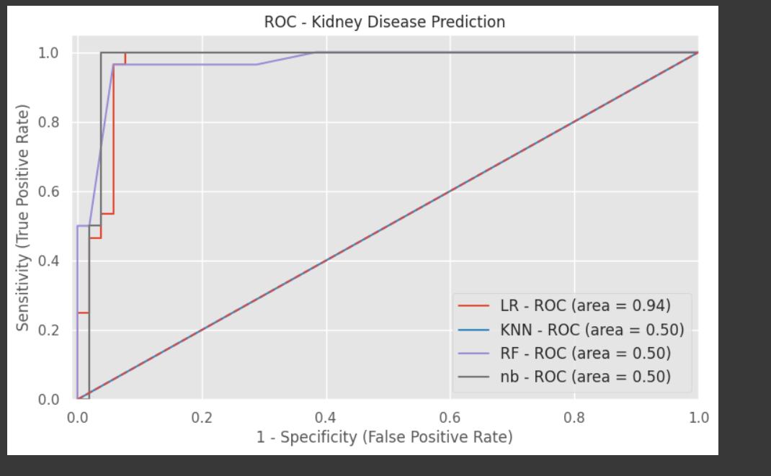
ROC – kidney disease Prediction
The images depict Python code and ROC curves for evaluating machine learning models in predicting kidney disease. The code shows models like Logistic Regression (LR) and Decision Trees (DT) being trained and assessed. ROC curves plot Sensitivity against 1-Specificity to evaluate model performance. LR outperforms other models with an AUC of 0.92, indicating high accuracy in distinguishing between positive and negative kidney disease cases, while other models have an AUC of 0.50, equivalent to random chance. Such analysis helps in selecting the best model for predicting medical outcomes.

Slide 23
DEPLOYMENT
We'll seamlessly integrate the CKD prediction model into existing clinical workflows:
Integration: incorporate the model into healthcare systems and EHRs.
User interface: create a user-friendly interface for inputting patient data and receiving instant risk assessments.
Scalability: ensure the model can handle large volumes of data and scale as needed.
Implementation involves pilot testing, user feedback, and staff training:
Pilot testing: evaluate performance in a real-world setting.
Feedback and training: gather input for improvements and provide staff training.
Benefits include early identification of at-risk patients, improved care, and resource optimization. We'll continuously update the model and explore expansion opportunities beyond CKD.
This approach ensures smooth integration and valuable insights for patient care.

Slide 24
CONCLUSION
Our CKD prediction model enables early identification of at-risk patients, facilitating timely intervention to prevent complications and improve patient outcomes.
With personalized risk assessments provided by the model, healthcare professionals can enhance patient care and management by tailoring interventions based on individual patient needs, such as medication adjustments, lifestyle modifications, and specialized monitoring.
This not only improves patient outcomes but also optimizes healthcare resources through targeted interventions, leading to more efficient allocation of resources and reduced healthcare costs.
Moreover, the model contributes to patient empowerment by promoting proactive healthcare management and fostering better patient-provider communication.
Additionally, the data generated by the model can be leveraged for research purposes, contributing to the advancement of medical knowledge and the development of innovative treatments for CKD and related conditions.

Slide 25
THANK YOU

